Slide 1
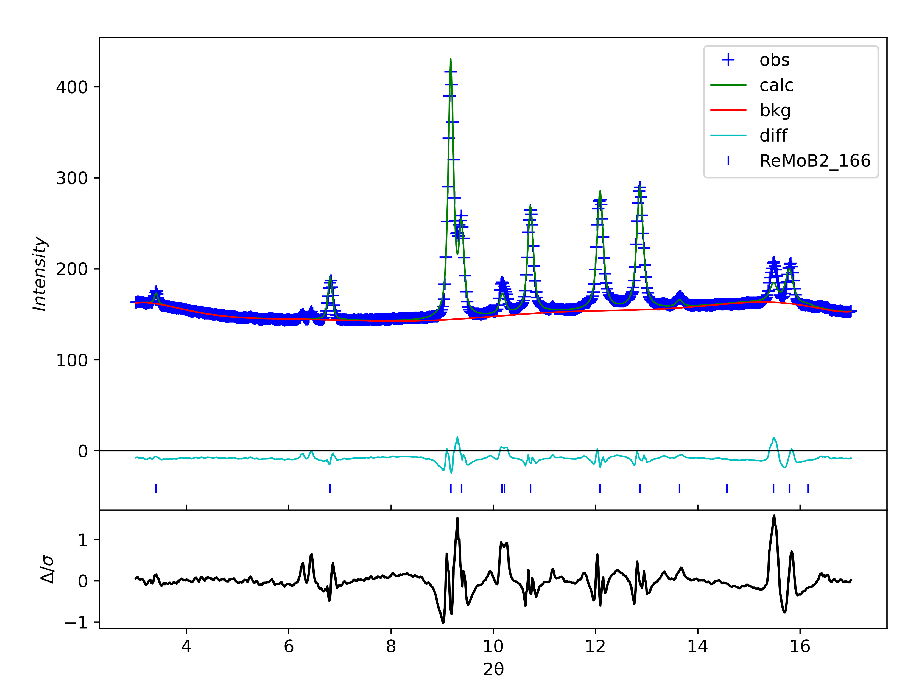
No.1 0GPa
wR=2.17%

Slide 2
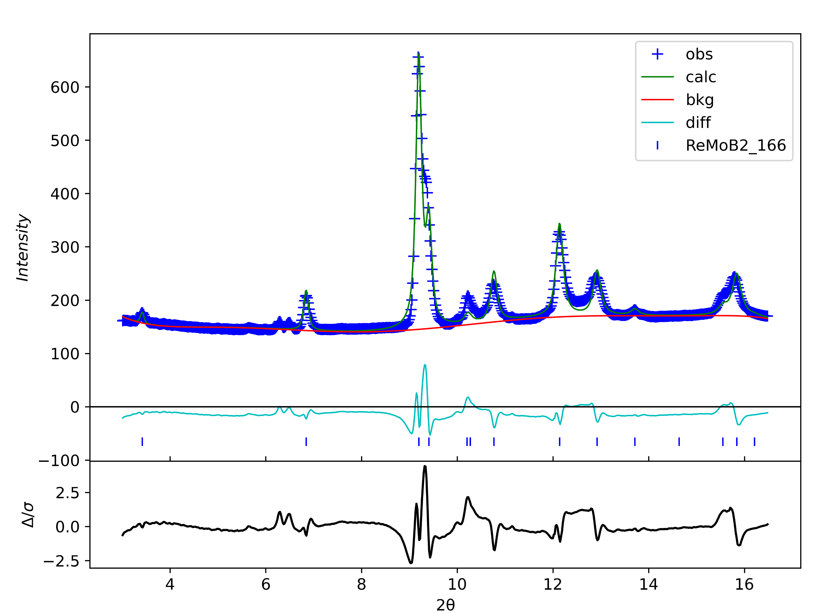
No.2 3.6GPa
wR=5.2%

Slide 3
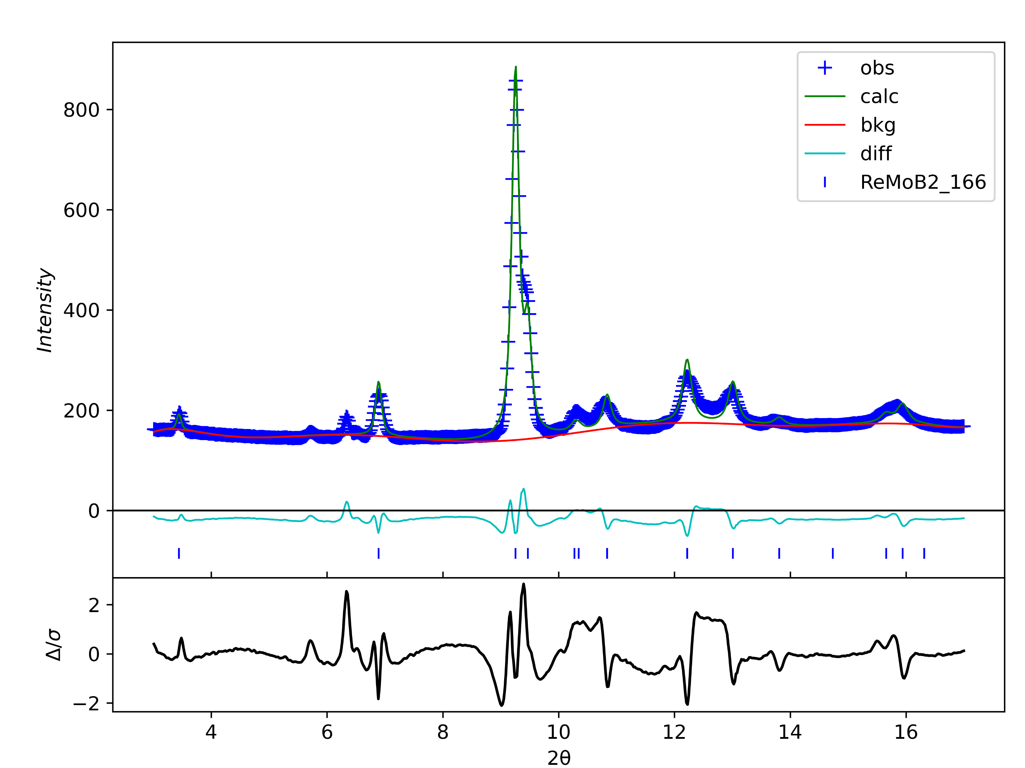
No.3 12GPa
wR=4.82%

Slide 4
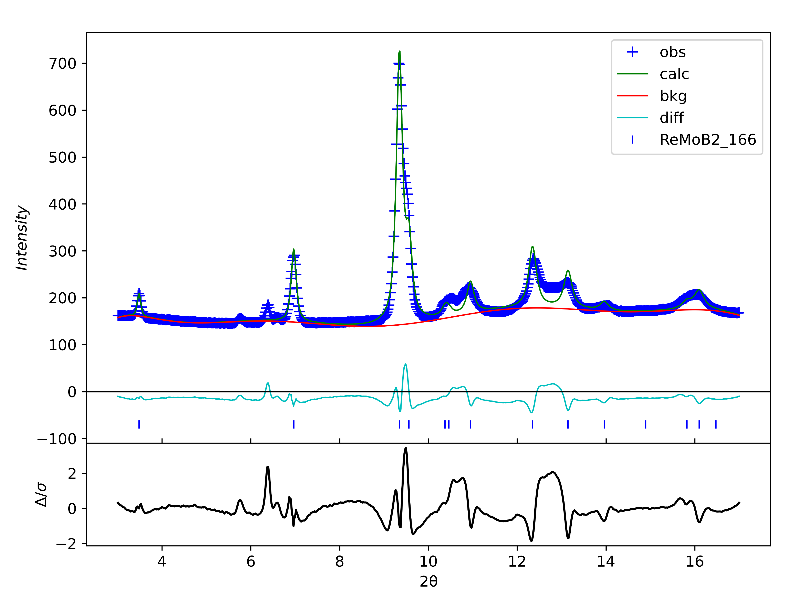
No.4 24GPa
wR=5.15%

Slide 5
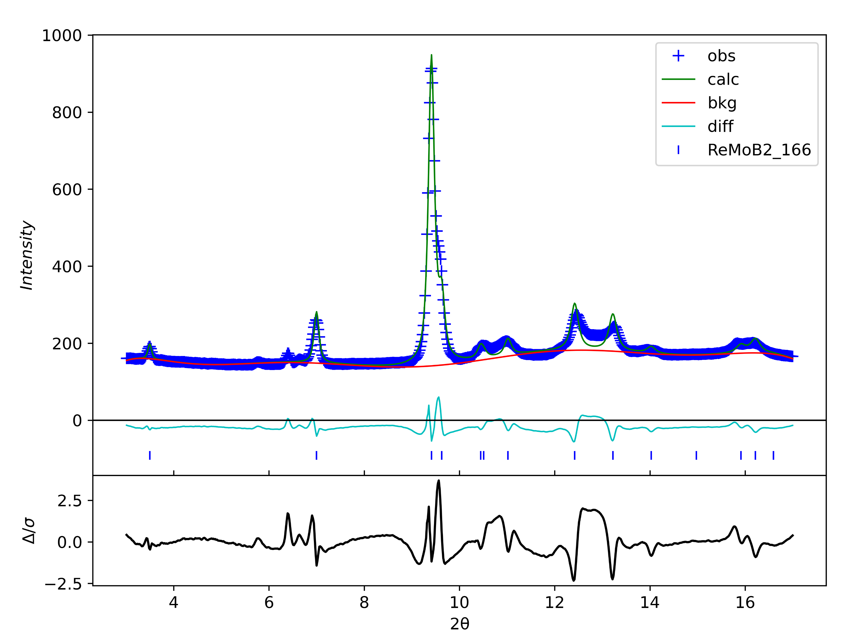
No.5 31GPa
wR=5.18%

Slide 6
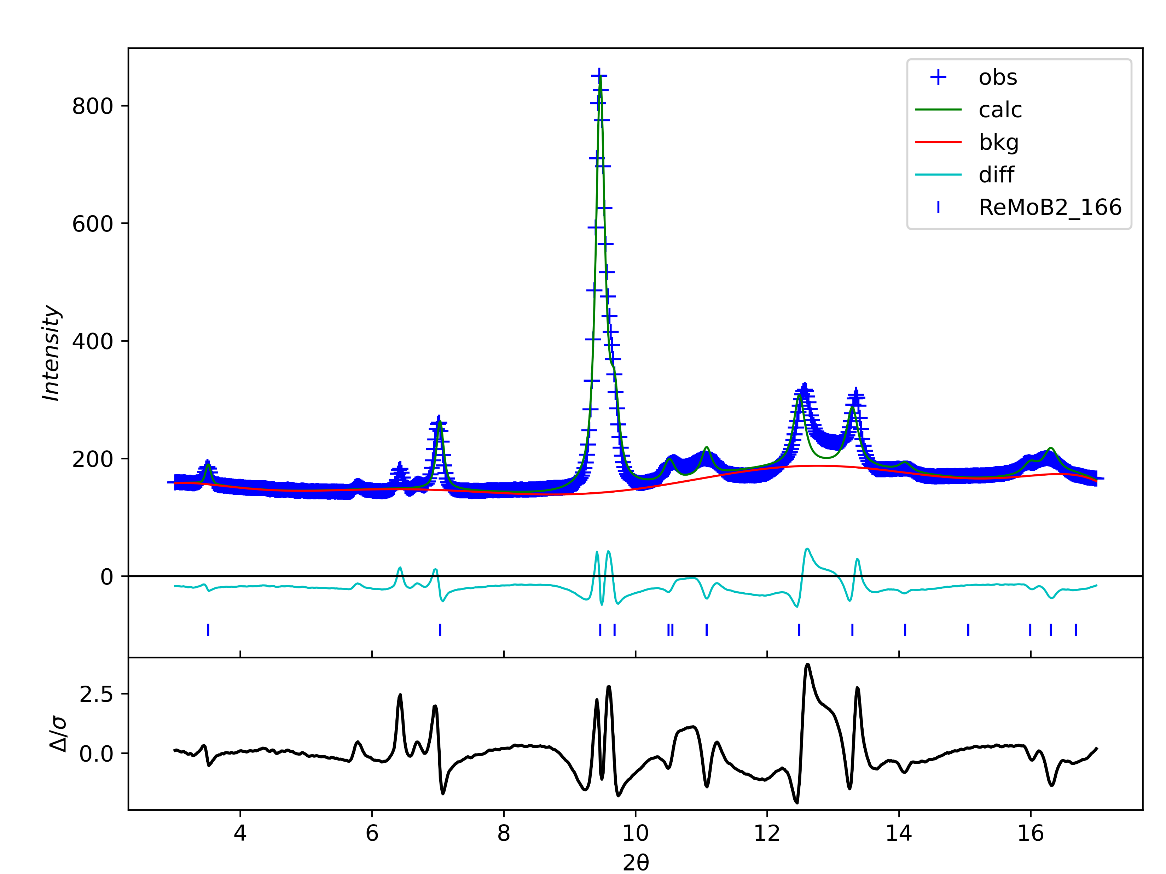
No.6 37GPa
wR=6.07%

Slide 7
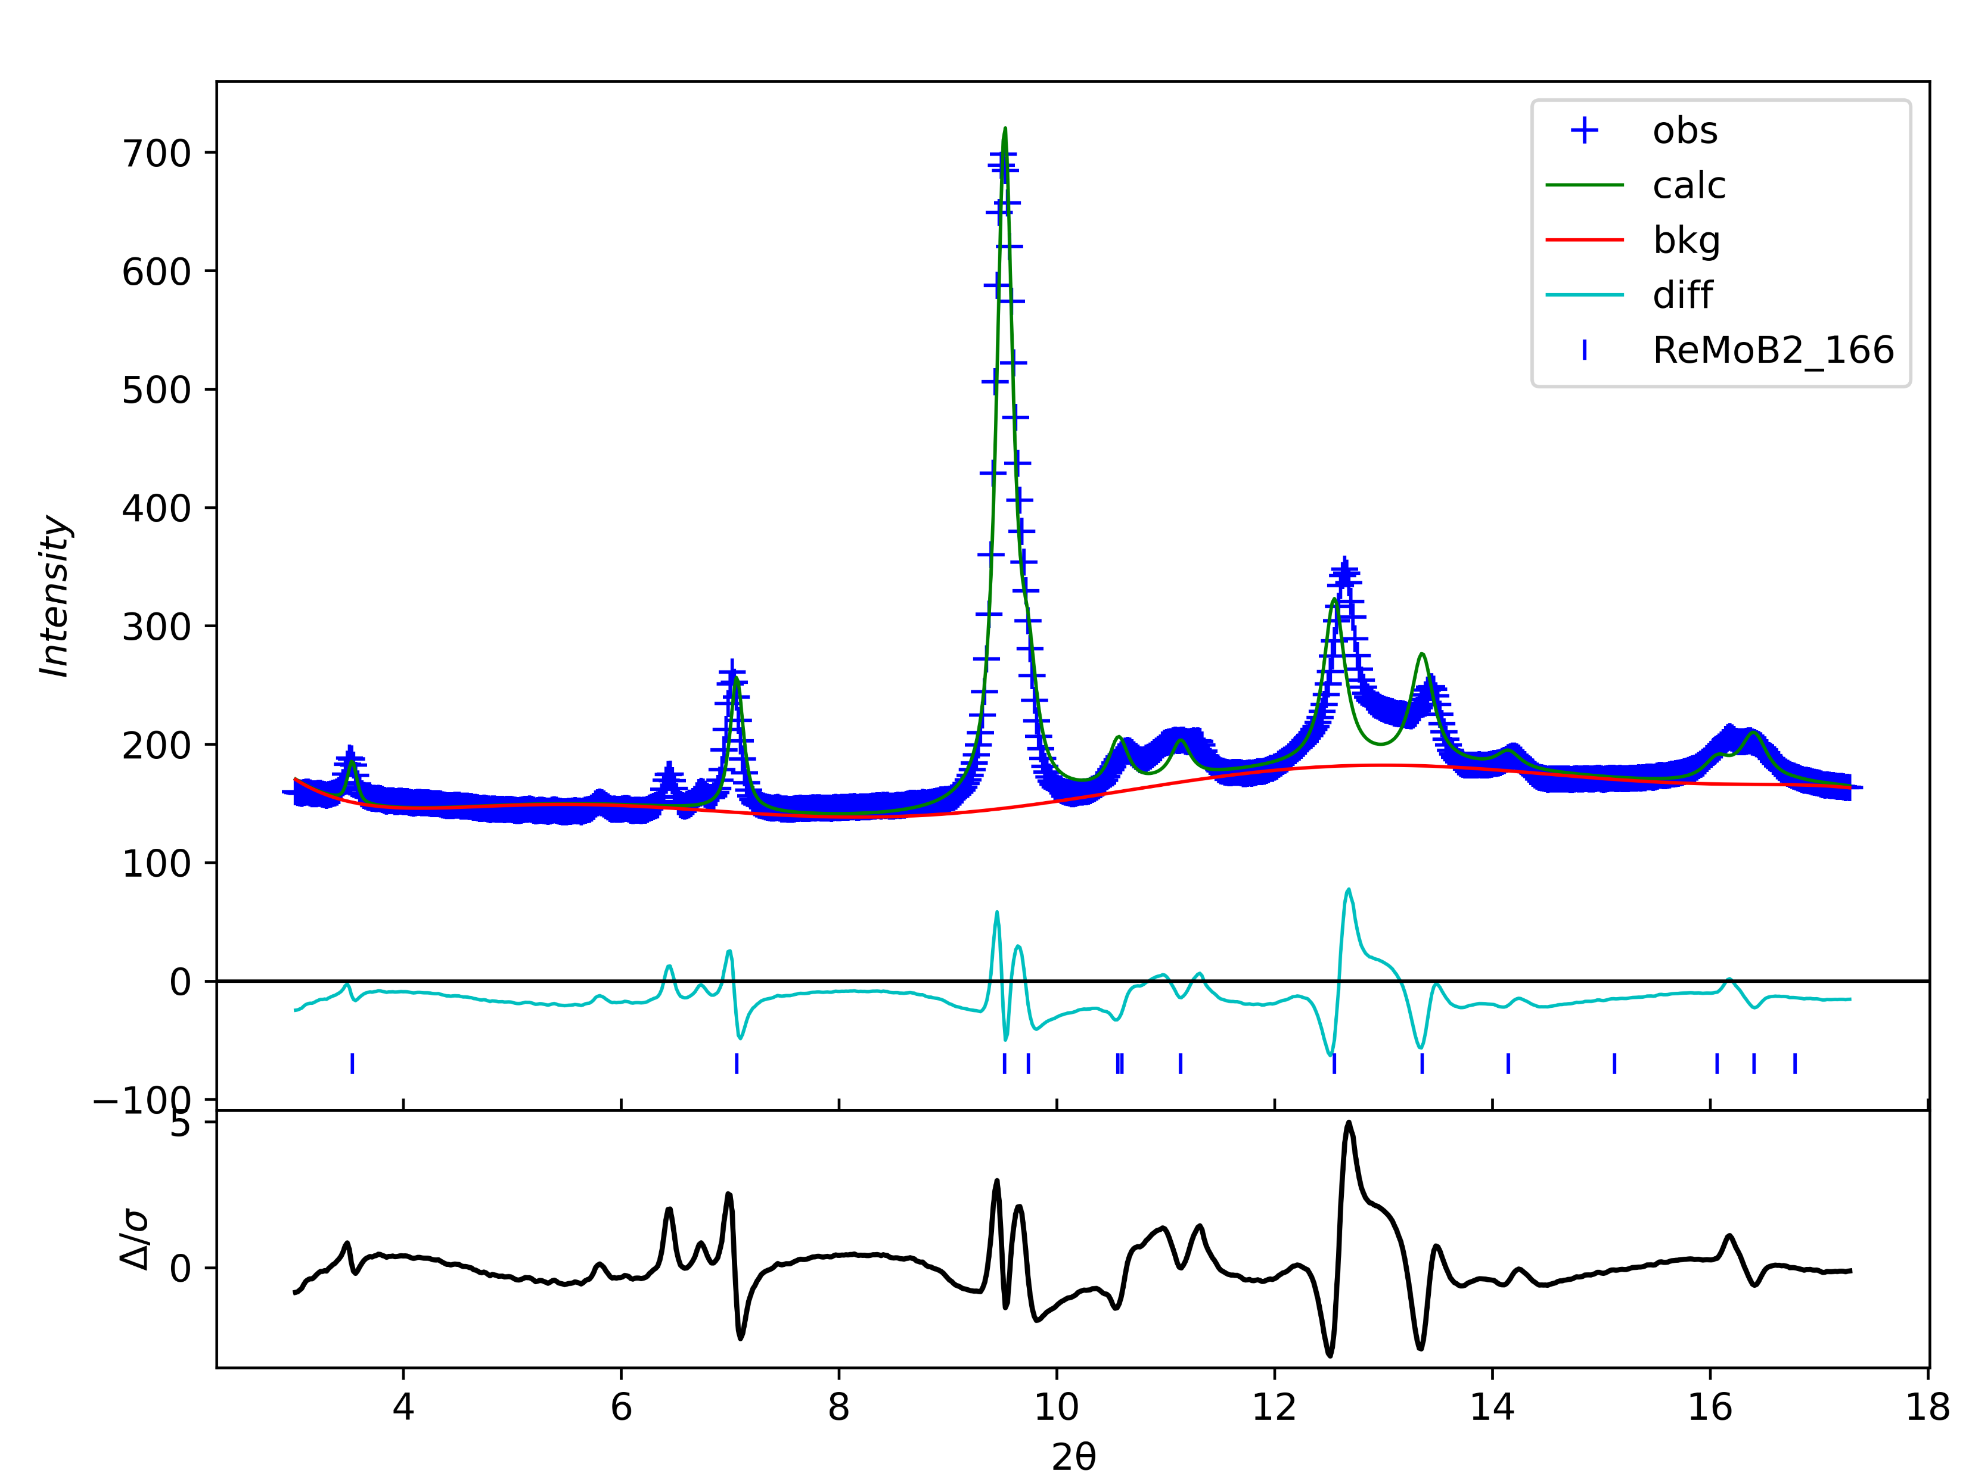
No.7 43GPa
wR=6.71%

Slide 8
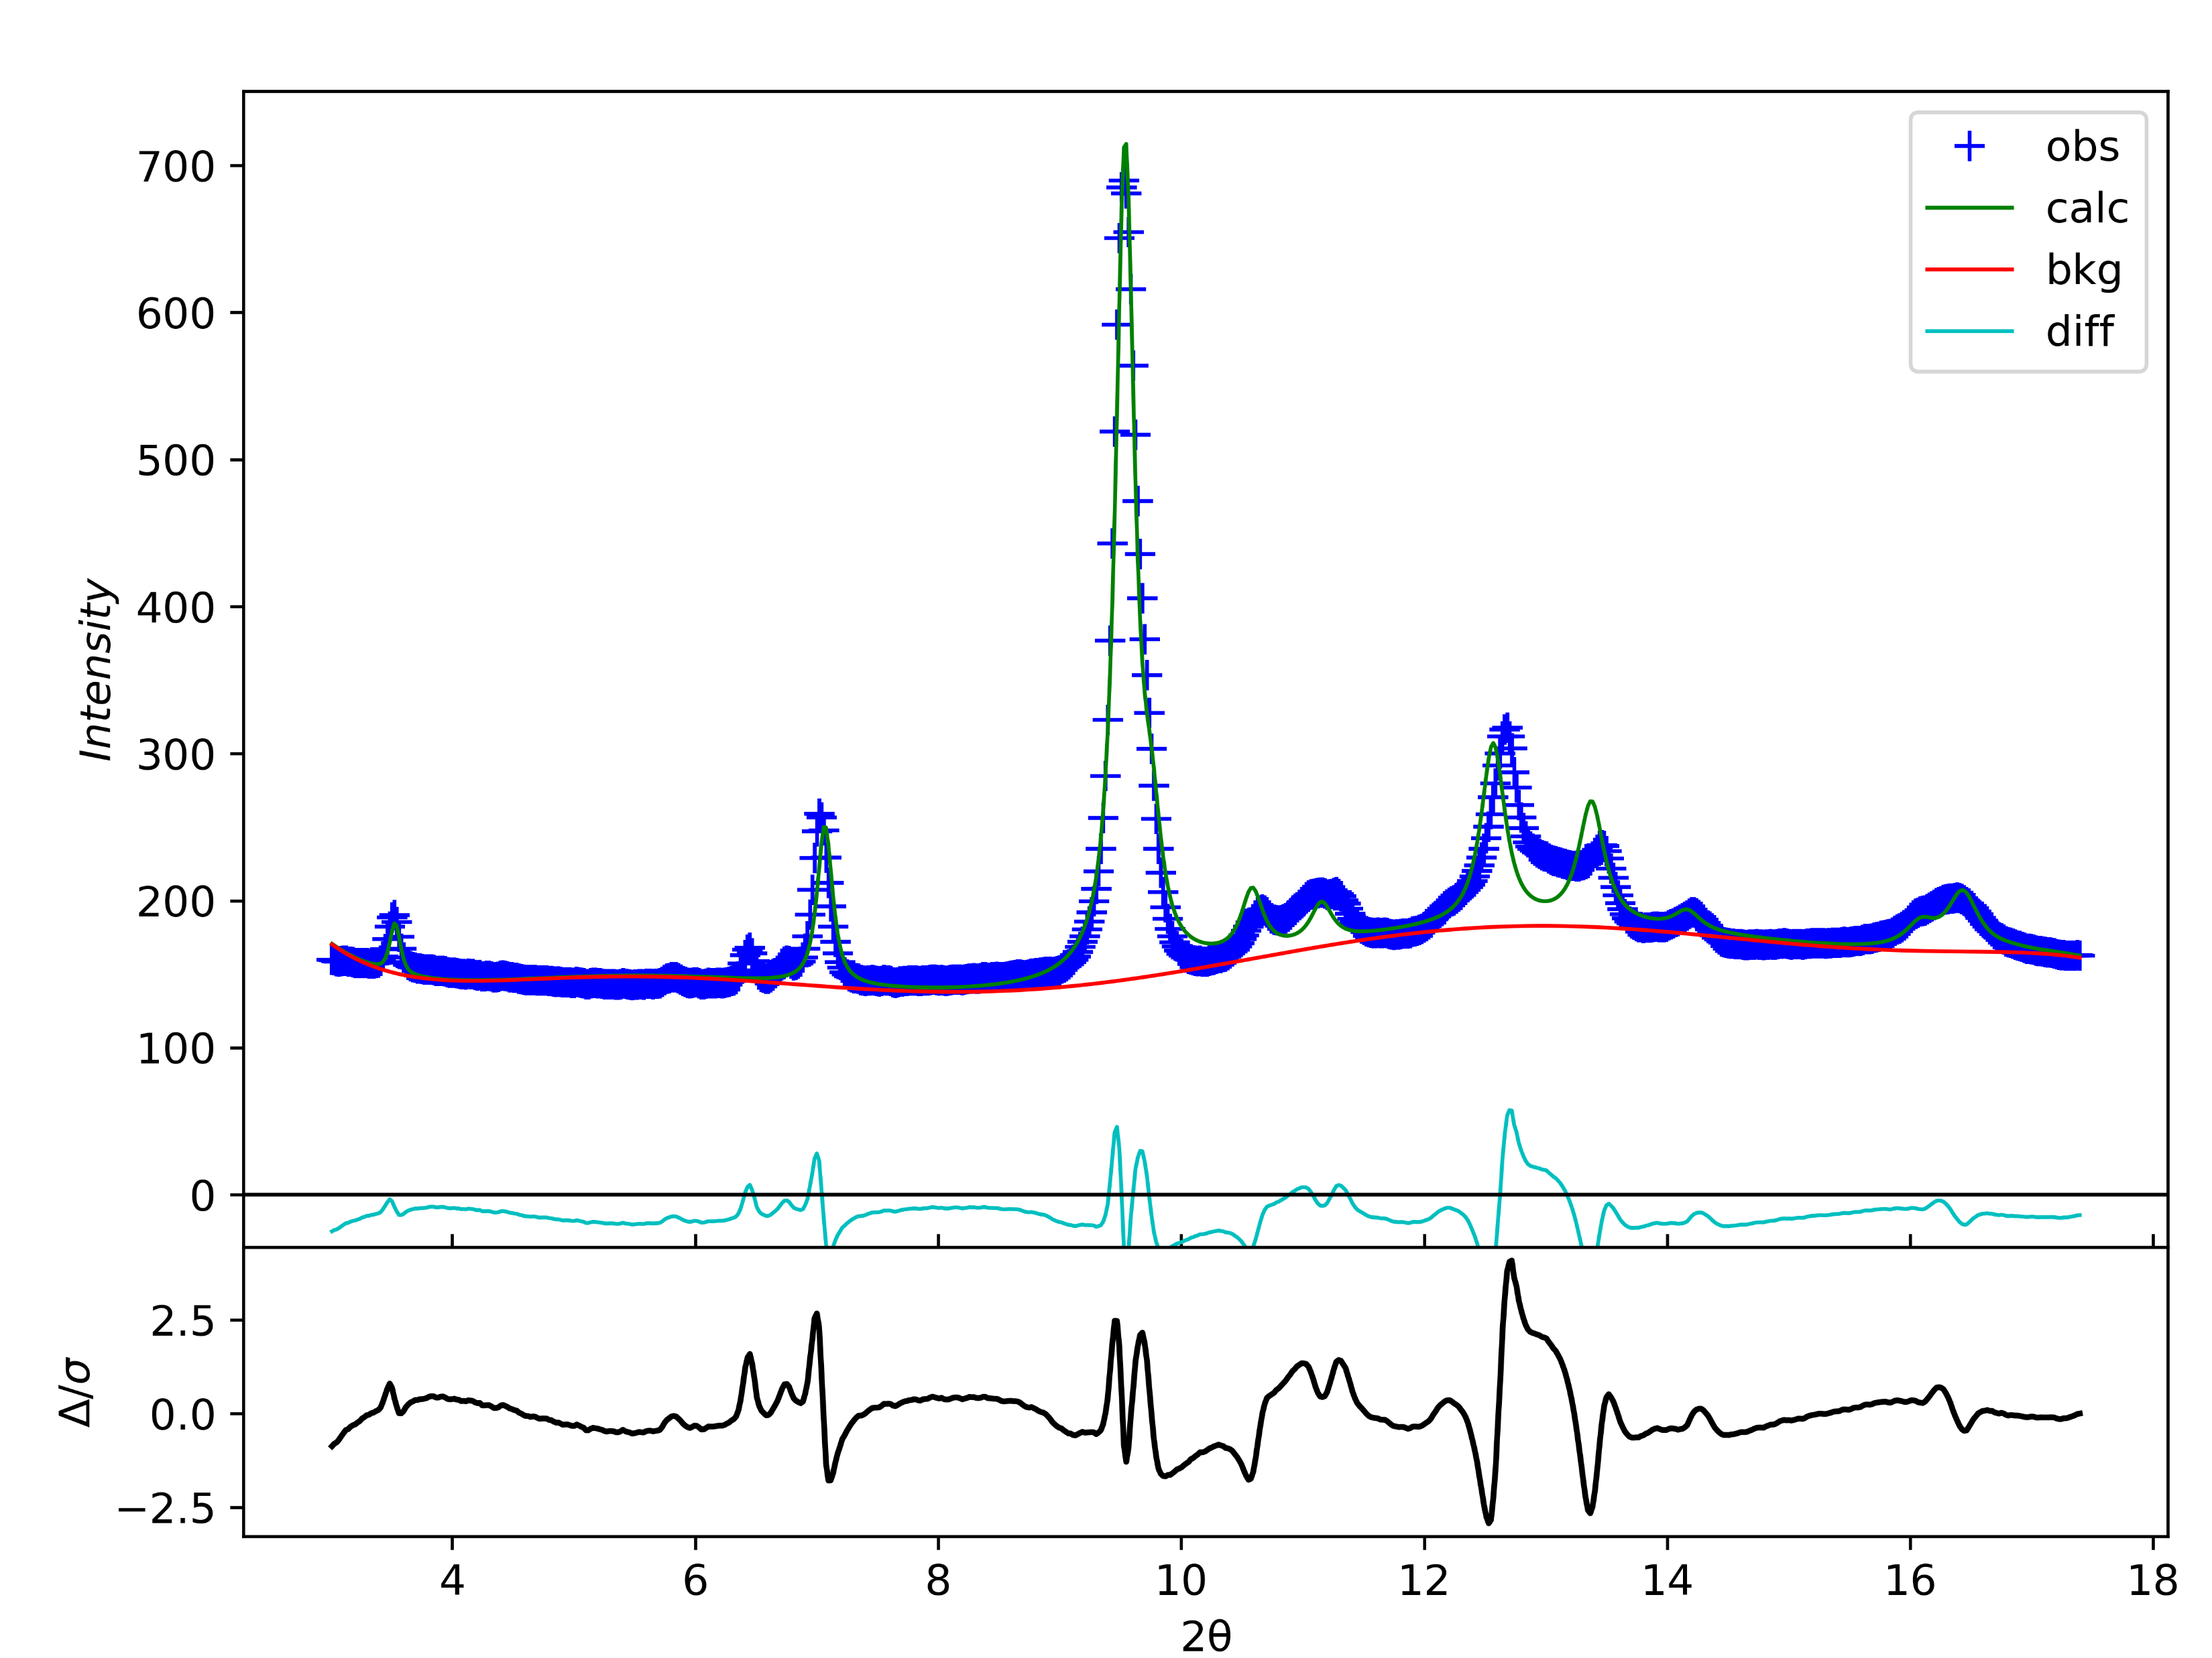
No.8 45GPa
wR=6.22%

Slide 9
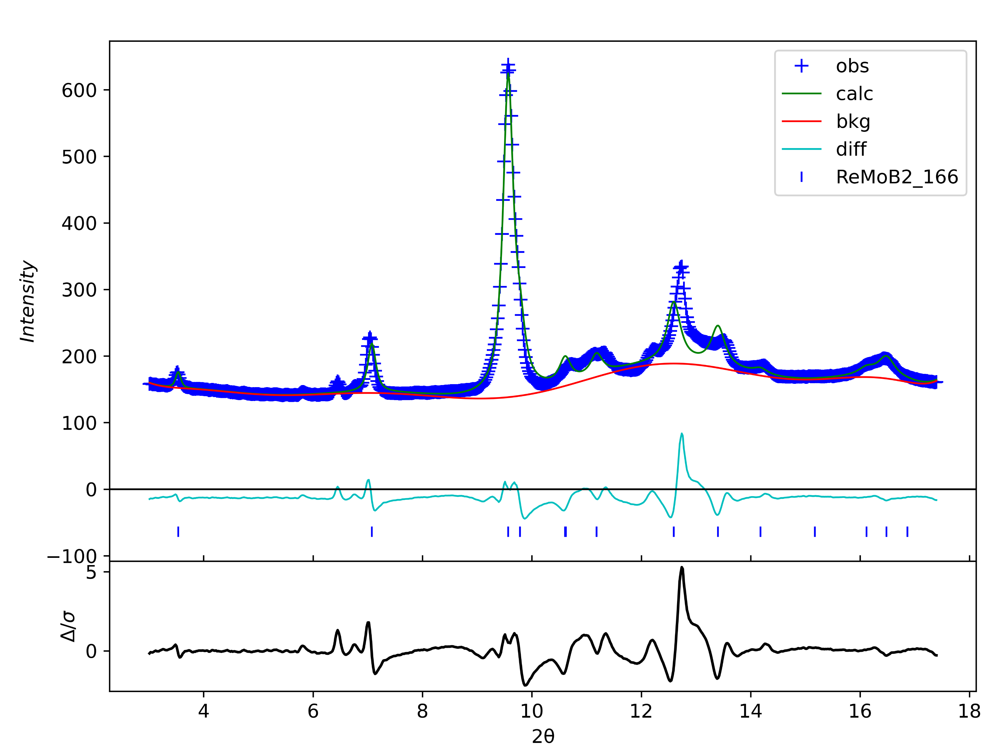
No.9 48GPa
wR=5.52%

Slide 10
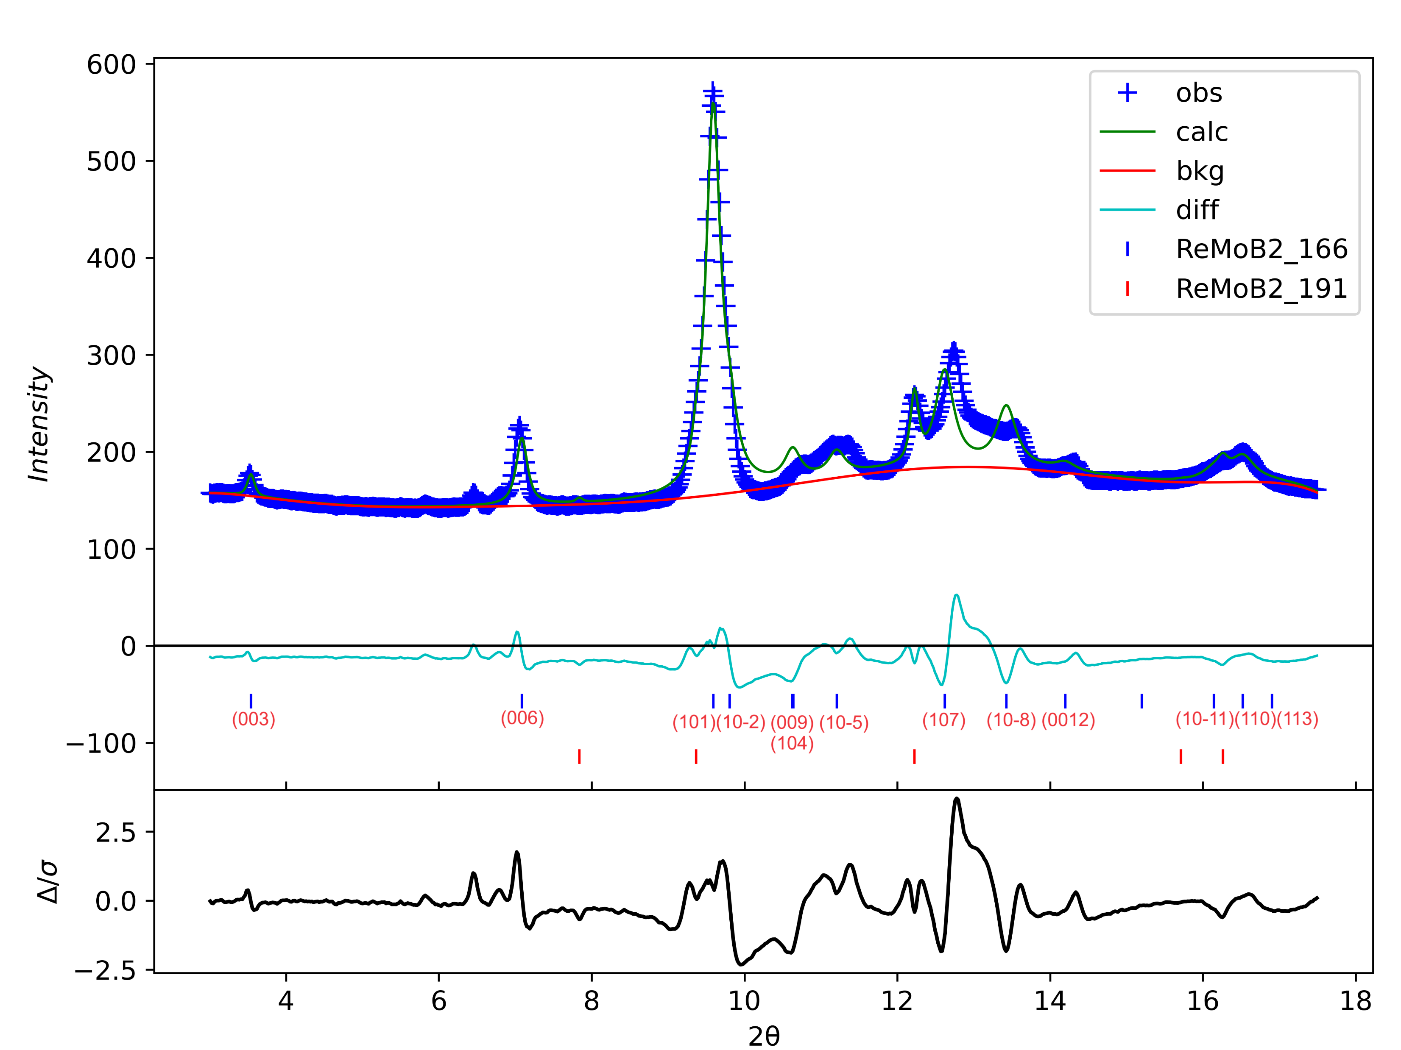
No.10 52GPa
wR=5.82%

Slide 11
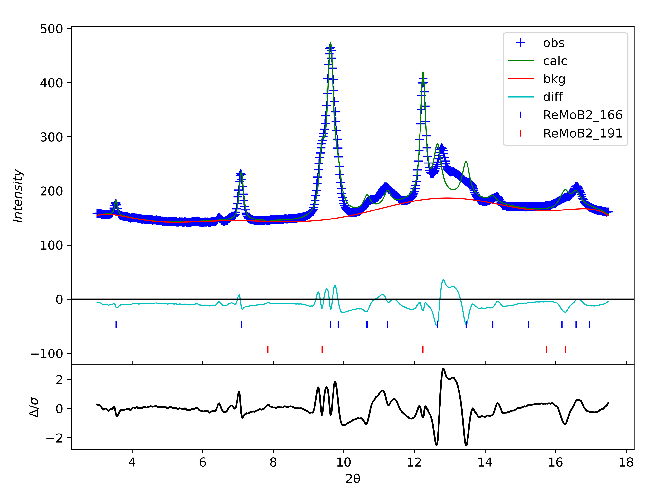
No.11 56GPa
wR=5.00%
Lattice parameters extracted for 191phase starting from this pressure point

Slide 12
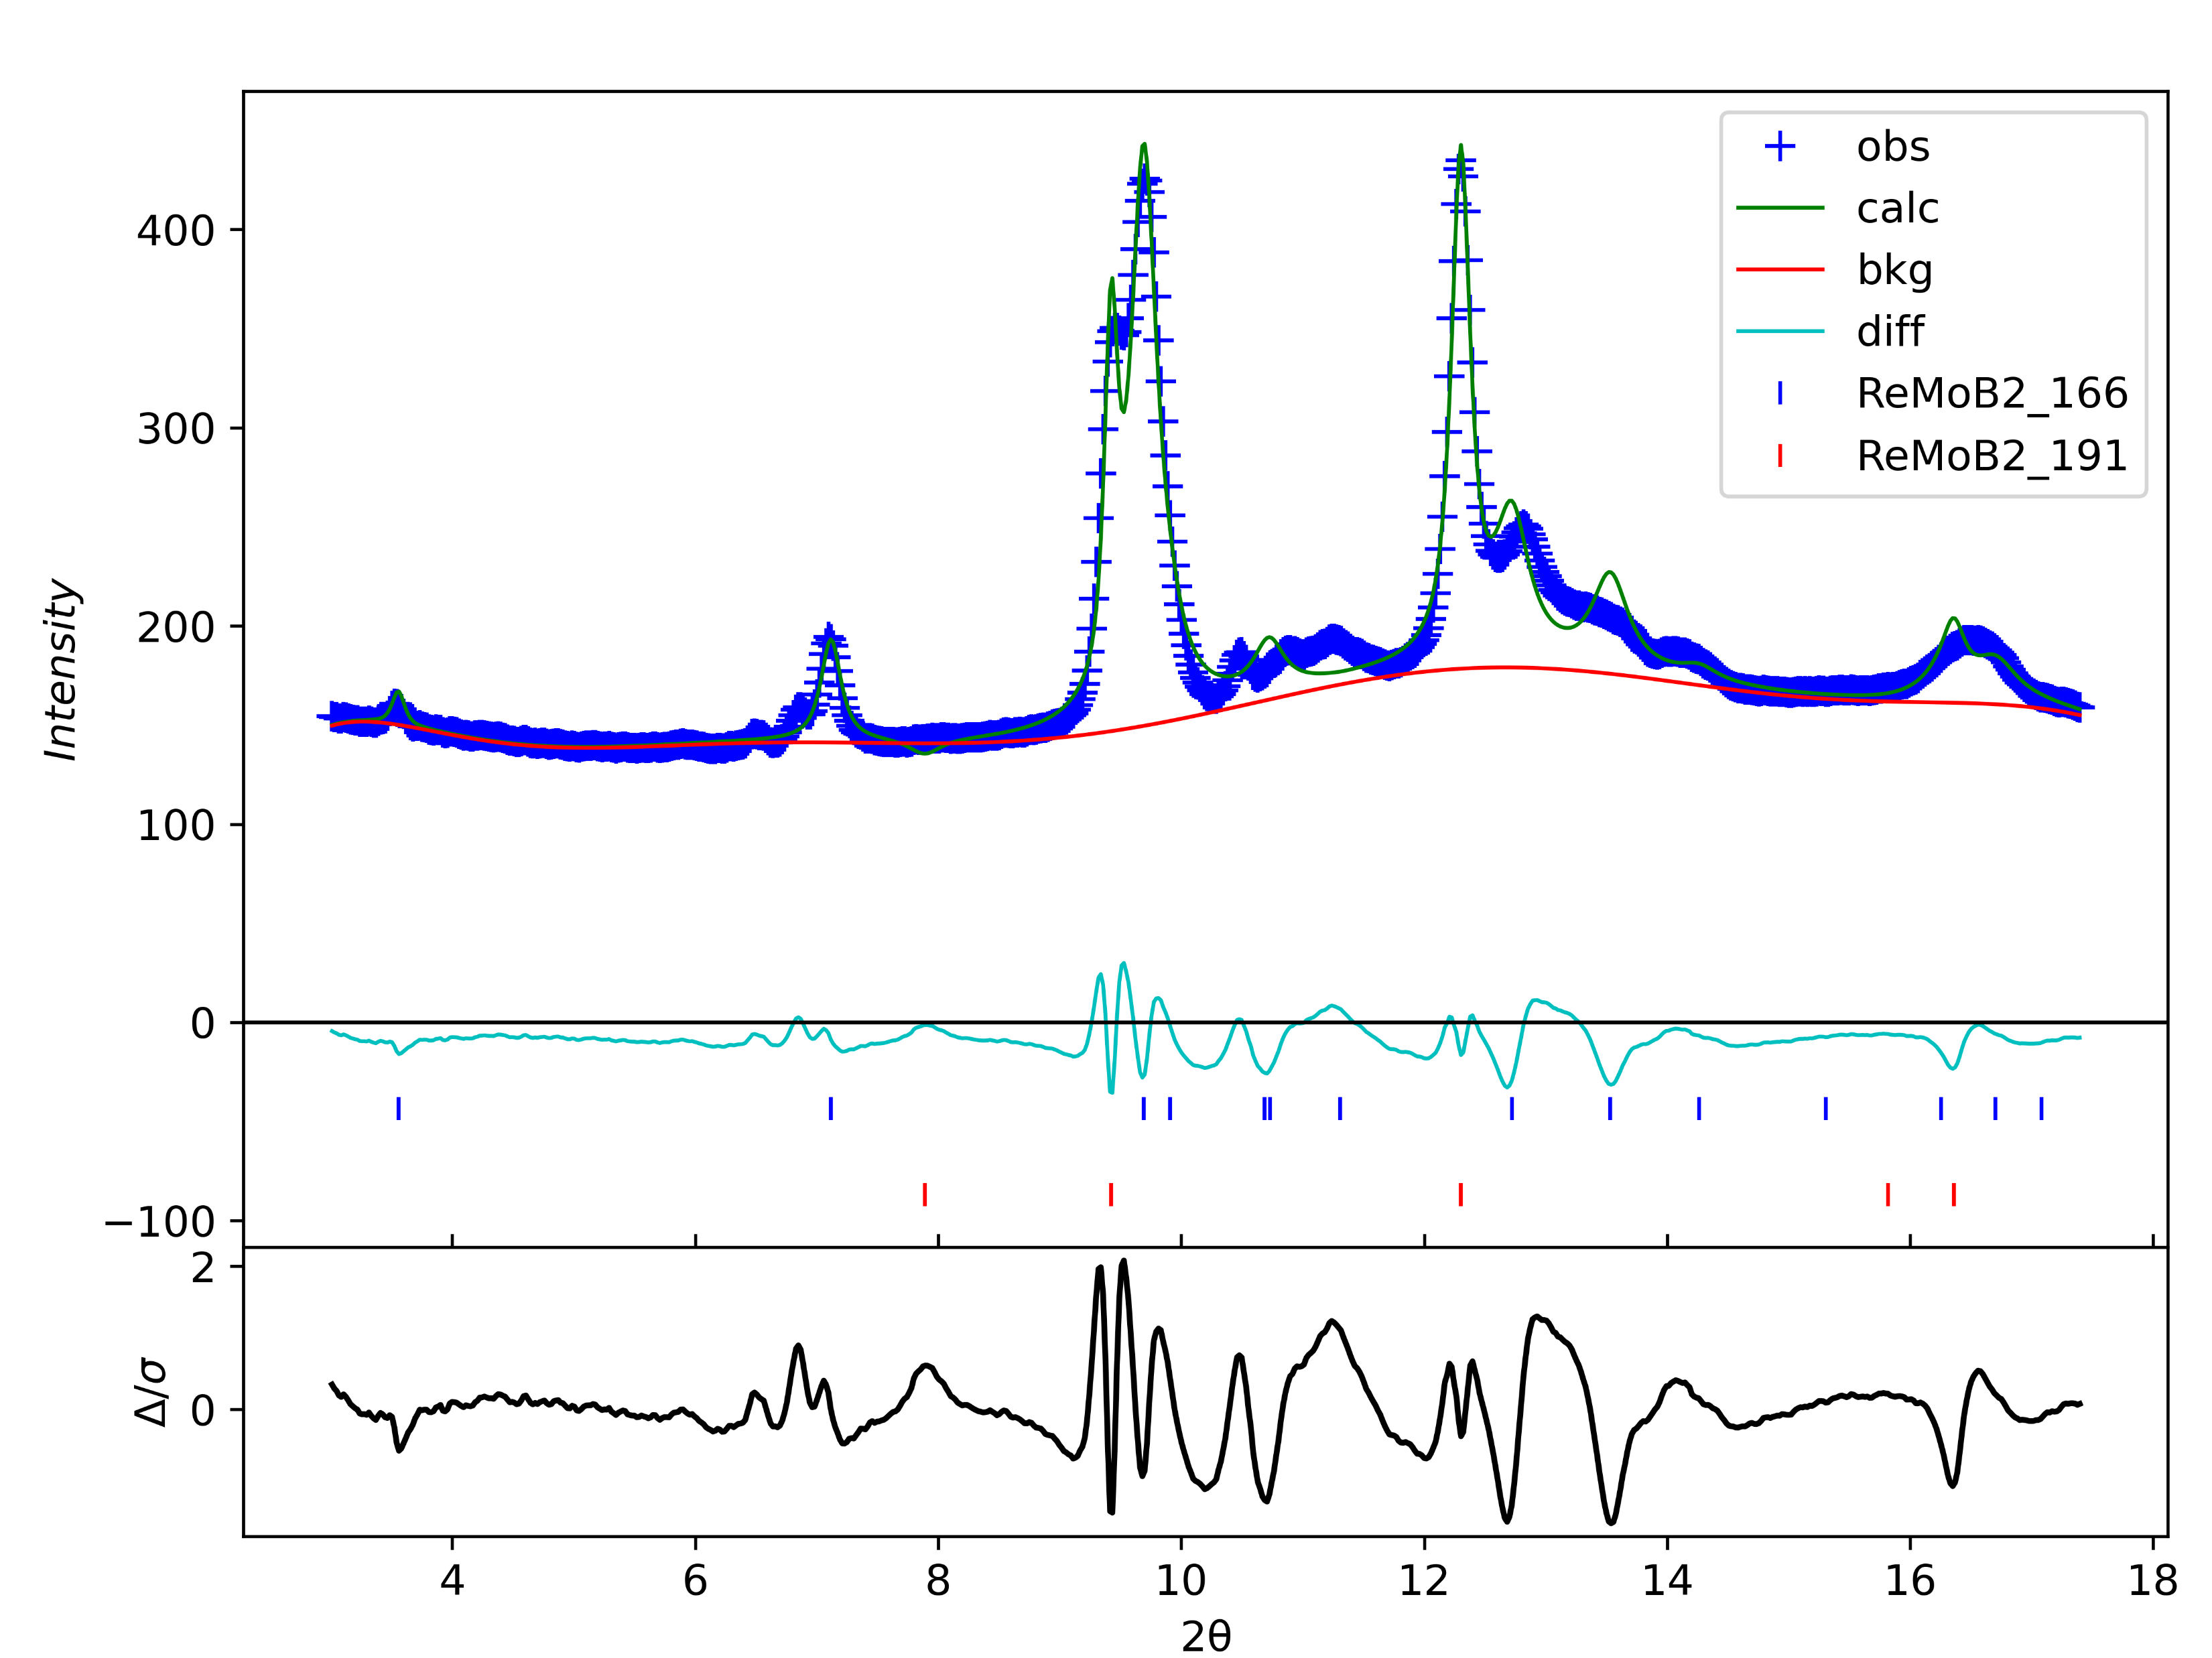
No.12 62GPa
wR=3.94%

Slide 13
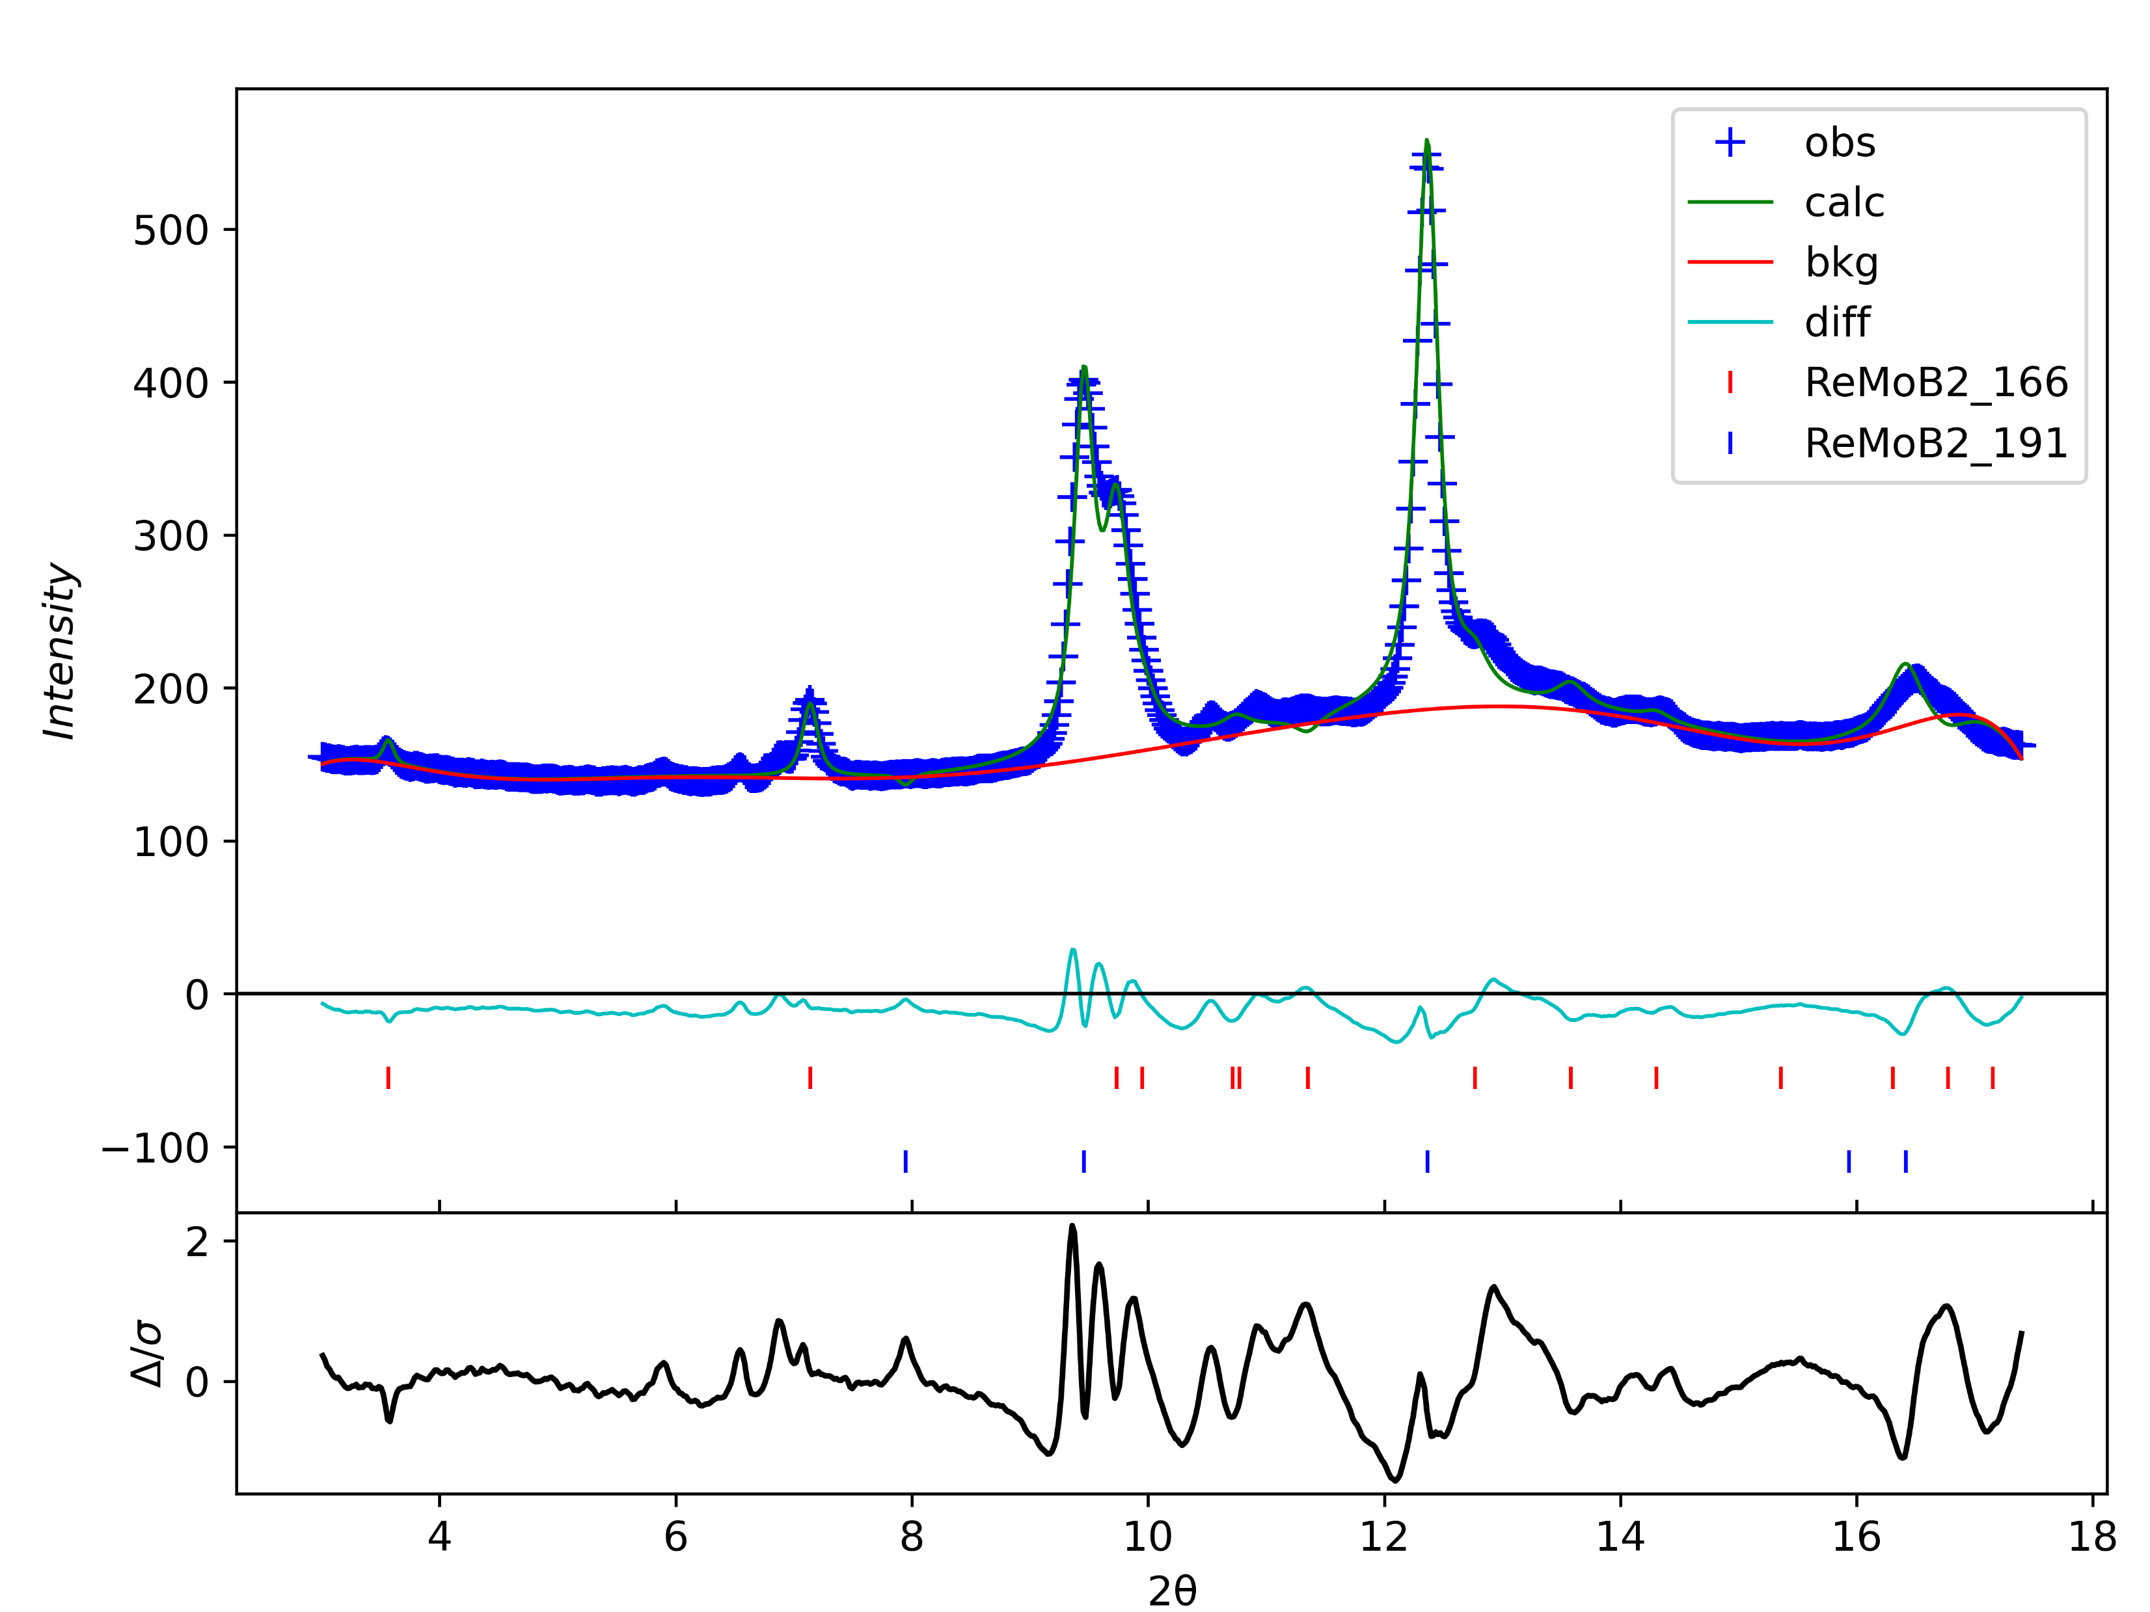
No.13 69GPa
wR=3.78%

Slide 14
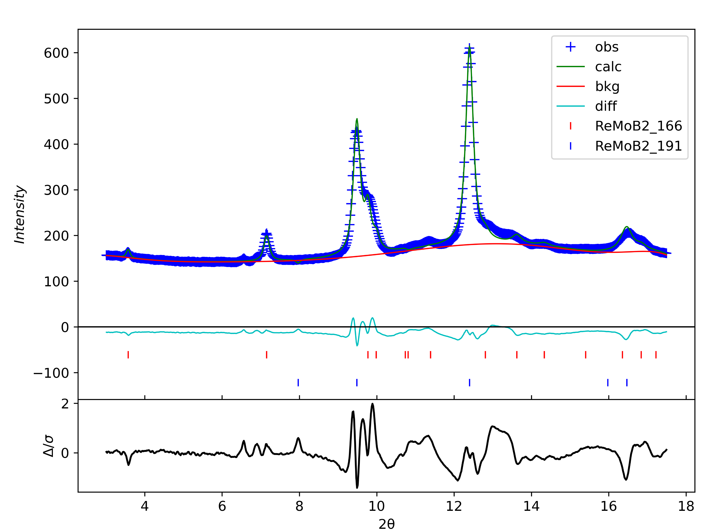
No.14 77GPa
wR=3.18%

Slide 15
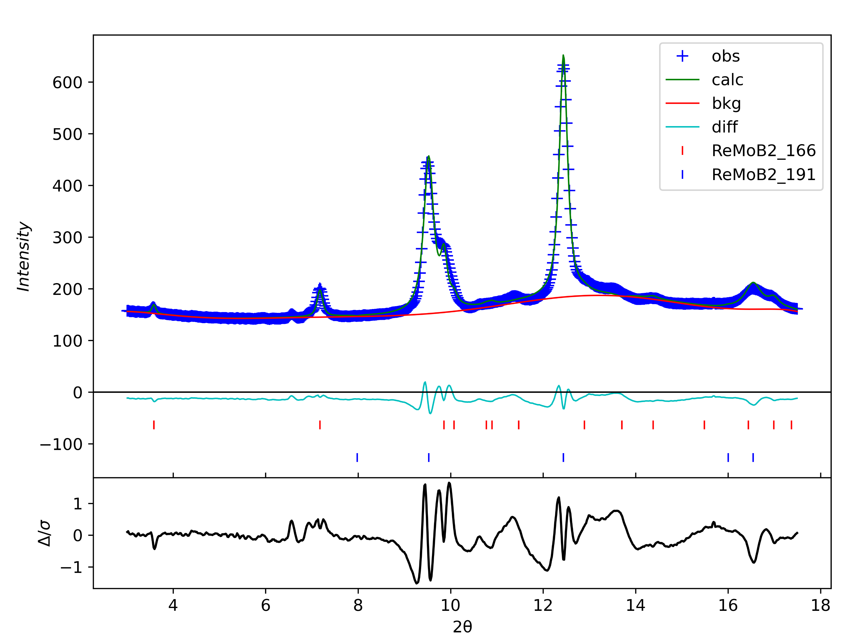
No.15 84GPa
wR=3.23%

Slide 16
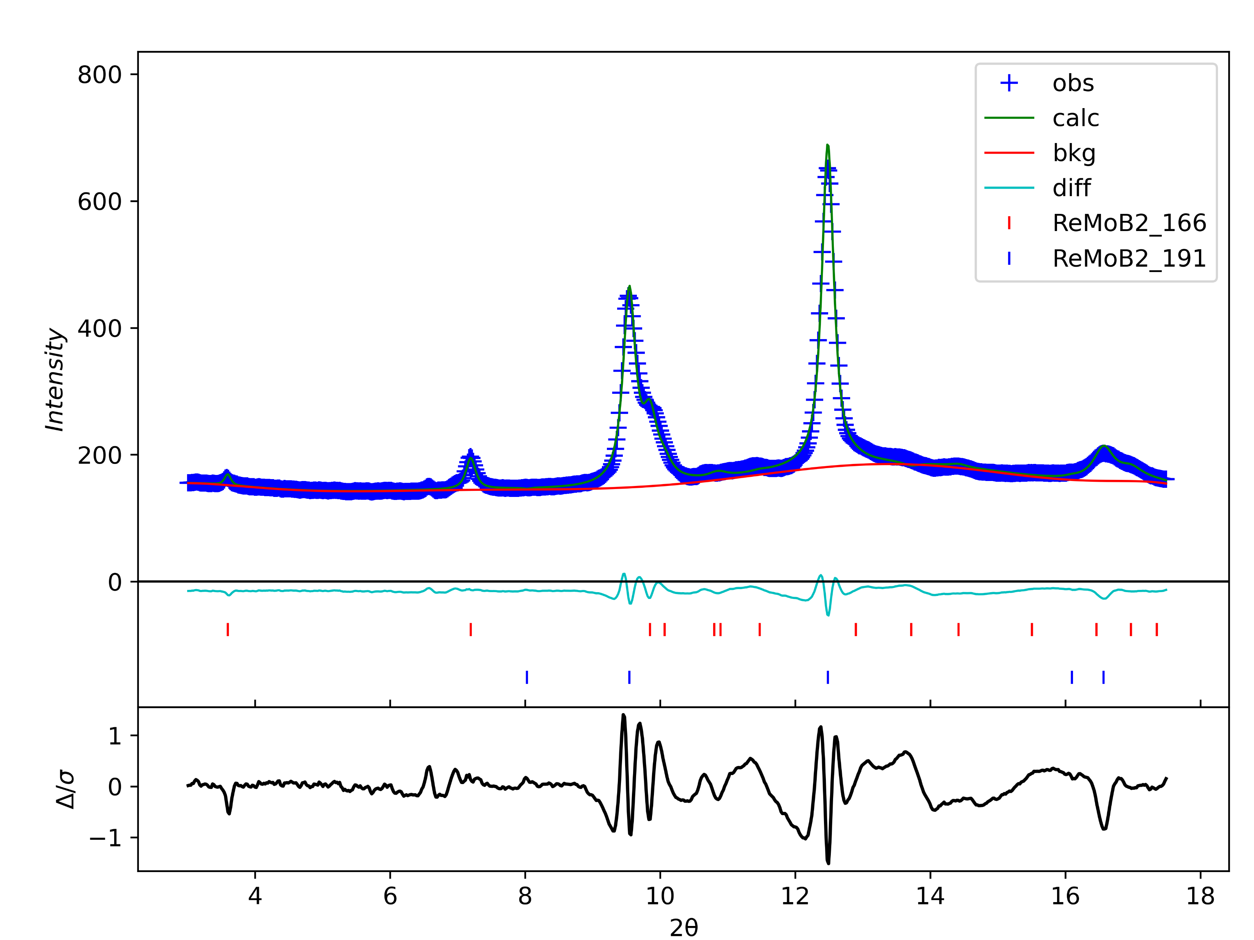
No.16 91GPa
wR=3.18%

Slide 17

No.17 98GPa
wR=3.18%

Slide 18
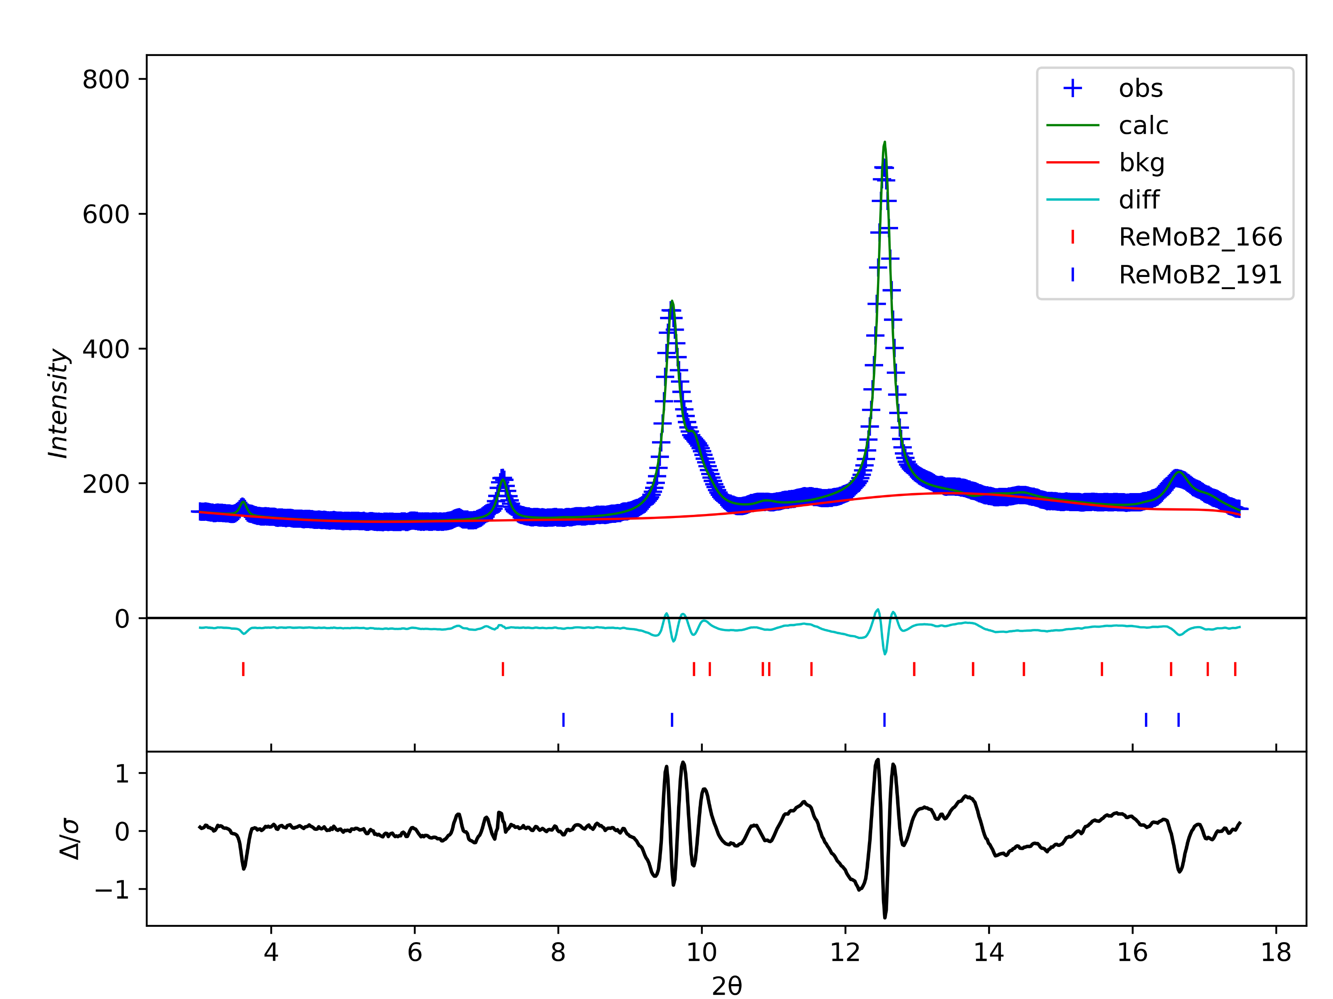
No.18 104GPa
wR=3.18%

Slide 19
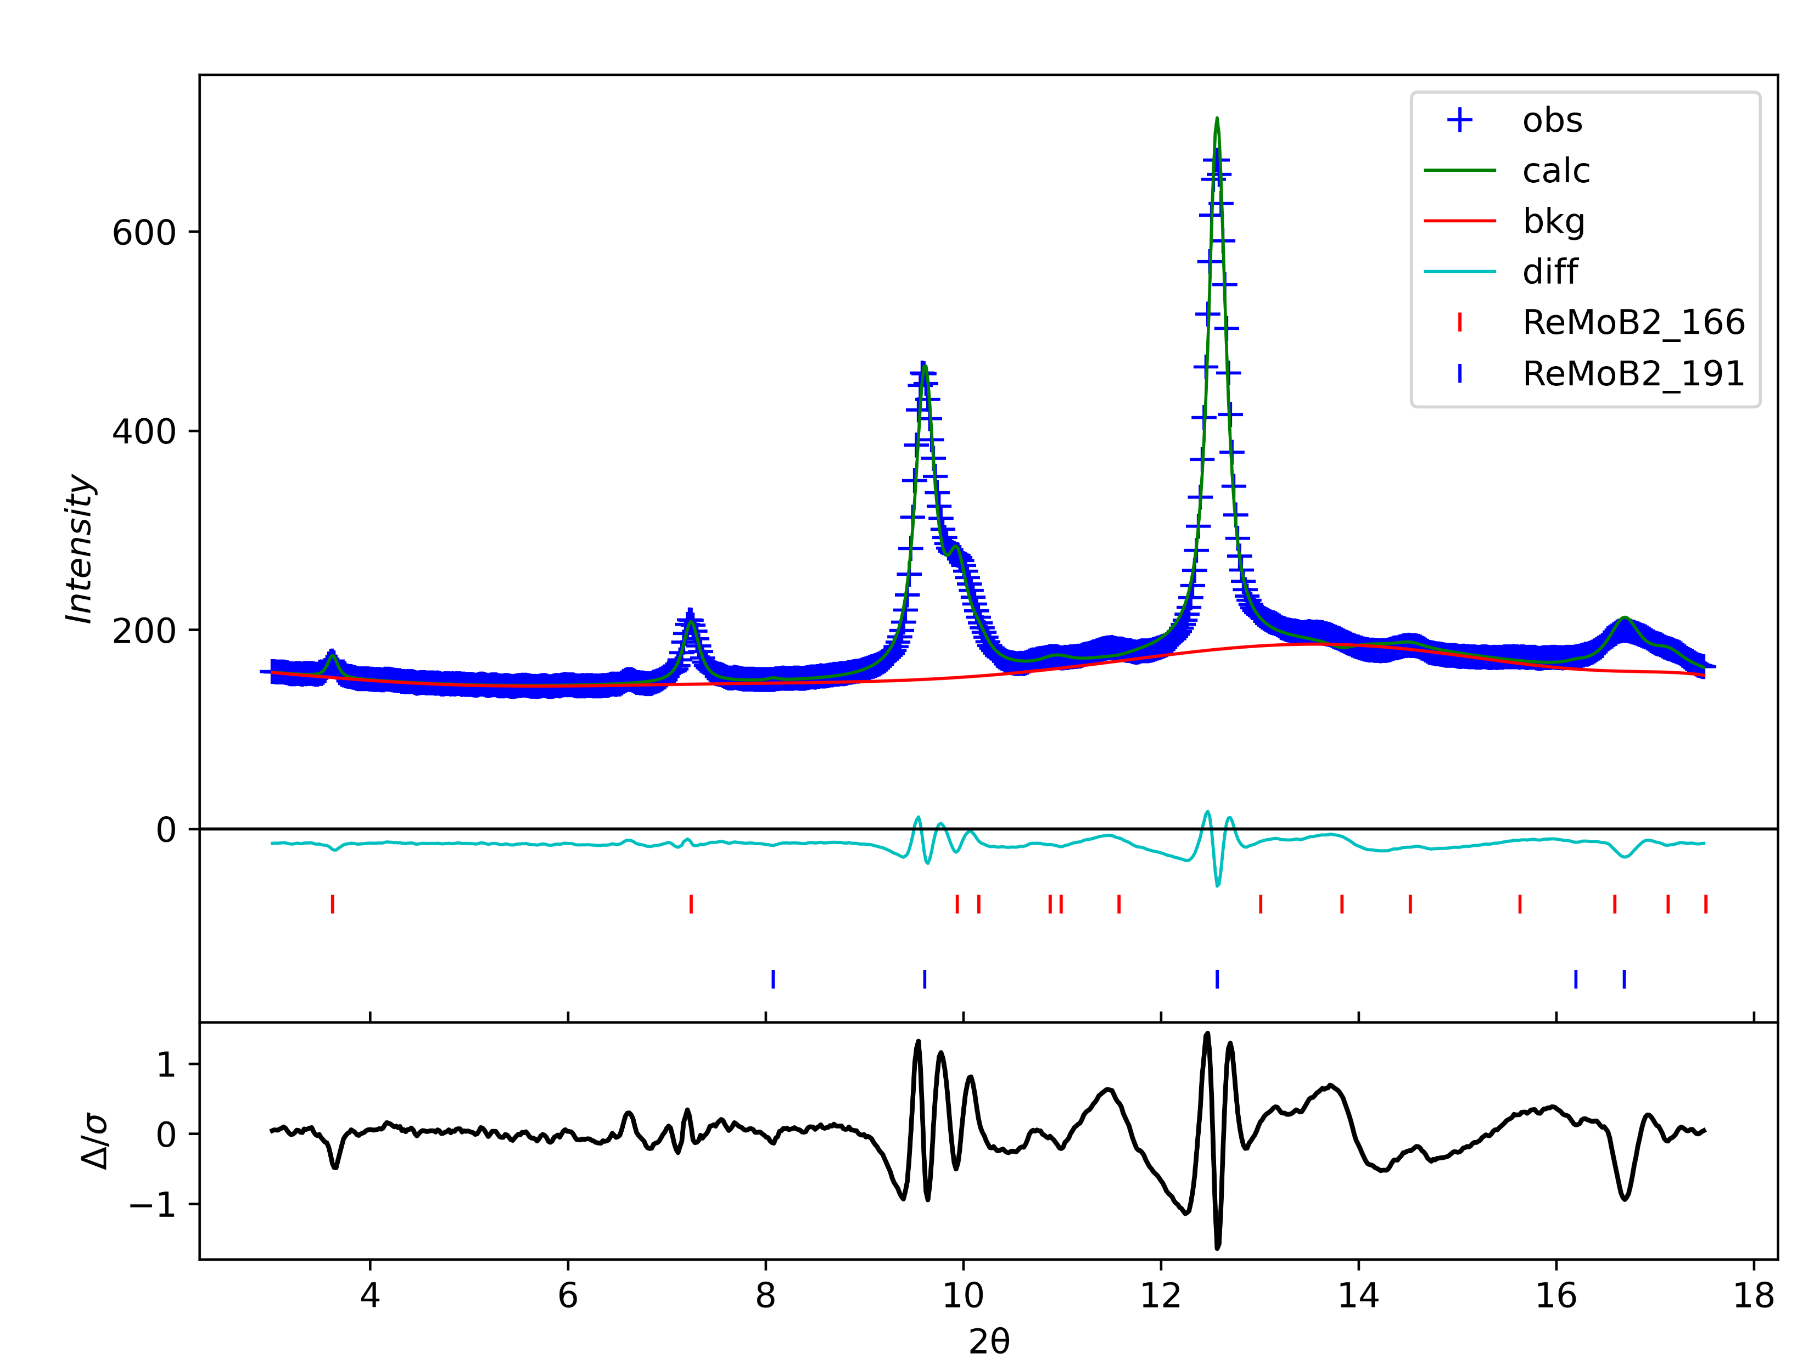
No.19 109GPa
wR=3.18%

Slide 20
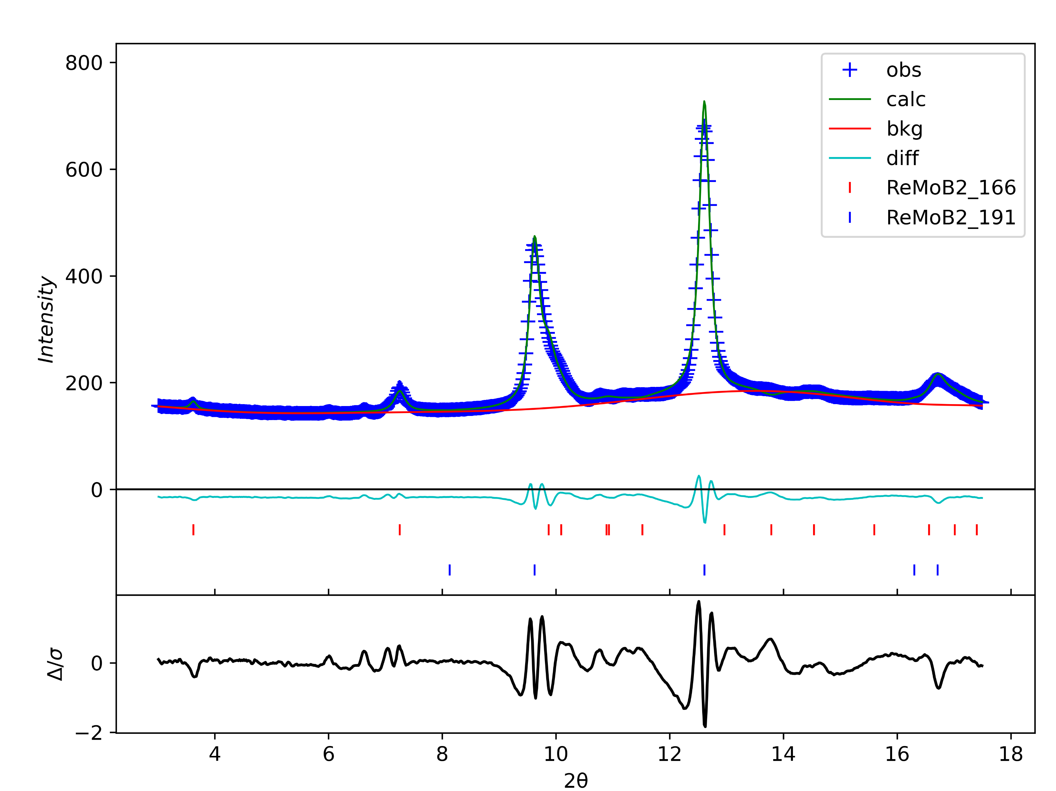
No.20 114GPa
wR=3.18%

Slide 21

No.21 119GPa
wR=3.18%

Slide 22

No.22 123GPa
wR=3.18%

Slide 23

No.23 128GPa
wR=3.18%

Slide 24

No.24 133GPa
wR=3.18%

Slide 25

No.25 138GPa
wR=3.18%

Slide 26

No.26 142GPa
wR=3.18%

Slide 27
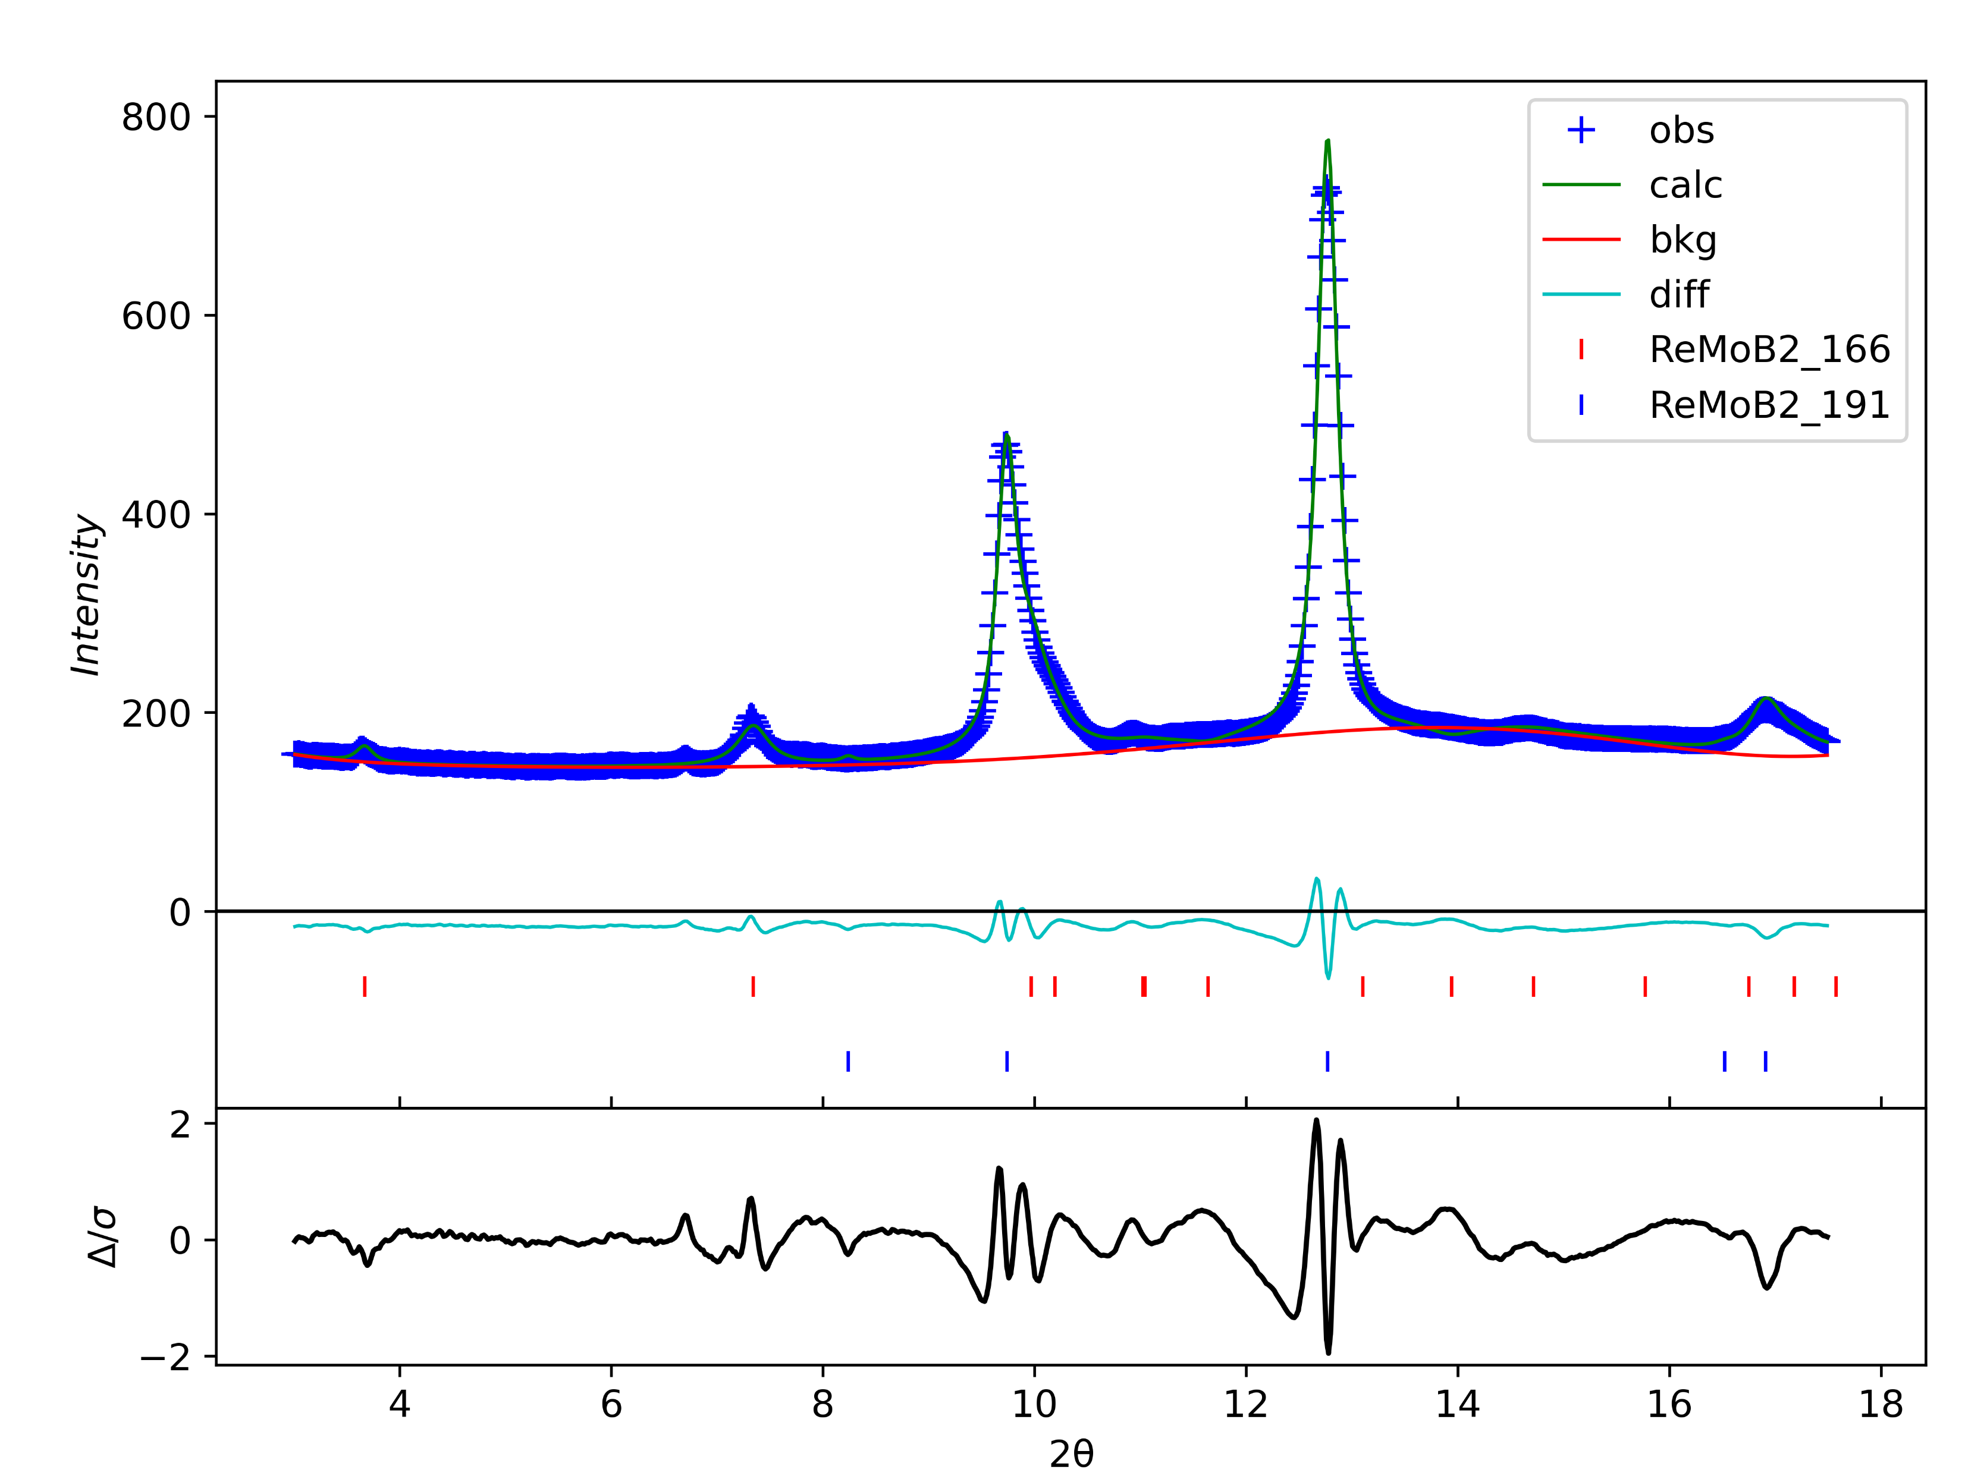
No.27 147GPa
wR=3.18%

Slide 28

No.28 168GPa
wR=3.18%

Slide 29
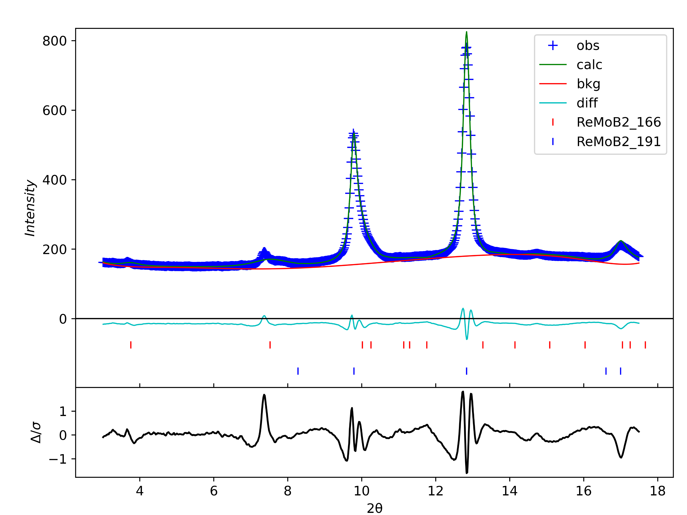
No.29 165GPa
wR=3.18%

Slide 30
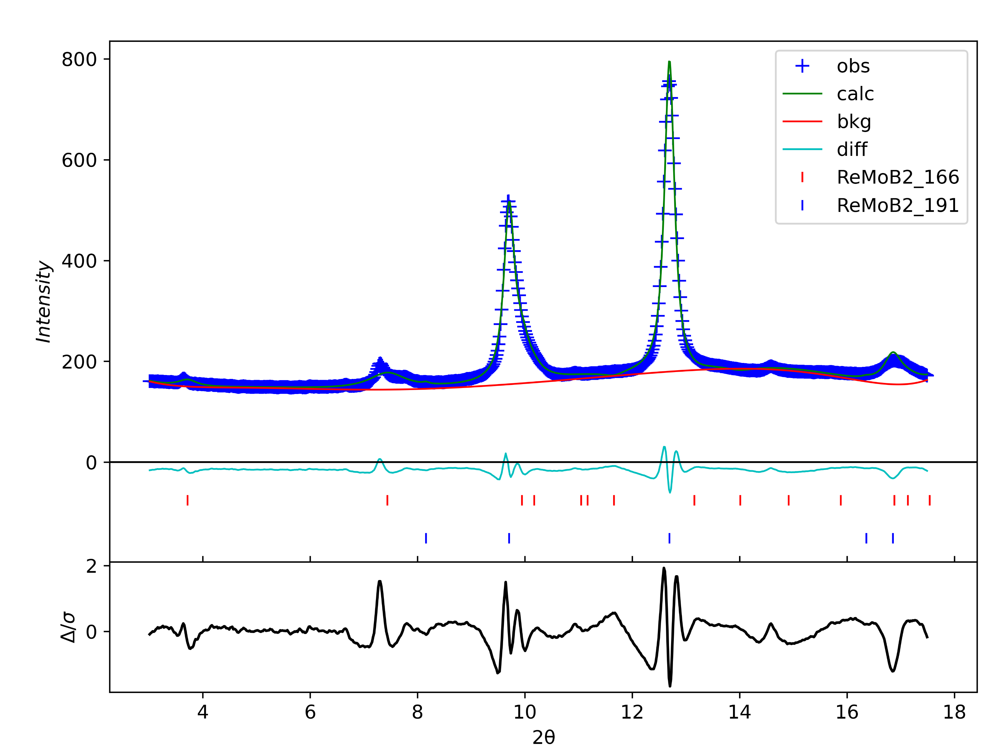
No.30 137GPa
wR=3.18%

